Slide 1

Iteration

Slide 2
Introduction
In this topic, we will
  Describe iteration
  Observe how it can be used to approximate solutions
  to algebraic problems
  Describe the fixed-point theorem
  Discuss issues such as the maximum number of iterations and the tolerances we are willing to accept in our approximations

Slide 3
Iteration
The next tool we will use is iteration:
  First, we require mathematical function f, which may
  represent a numerical algorithm
  Second, we require an initial value, or initial approximation, x₀
An iteration occurs when start applying f to x₀:
We can repeat this arbitrarily often to produce a sequence of
values
x₀, x₁, x₂, x₃, x₄, …
  The significance of this sequence depends on f and x₀

Slide 4
Iteration
The function f may be a simple arithmetic function,
or it may describe a complex algorithm involving a number
of steps
Here is a simple function:
  Even here, depending on the initial value,
  the behavior will change
    We will have initial values 0.1, 1 and 2:
  0.1, 0.01, 0.0001, 0.00000001, 0.0000000000000001, …
  1, 1, 1, 1, 1, 1, 1, 1, …
  2, 4, 16, 256, 65536, 4294967296, 18446744073709551616, …

Slide 5
Iteration
We have already seen one example of iteration
  If x approximates , then is on the other side of
    Consequently, the average of these two should be a better
    approximation of , so we define
  Now, x₀ = 1.4 has a 1% relative error if approximating
      x₁ = 1.414285714285714
      x₂ = 1.414213564213564
      x₃ = 1.414213562373095
      x₄ = 1.414213562373095

Slide 6

Iteration
Exercise:
  Come up with a similar formula for approximating for
  a given positive real number n
No solution is provided, and not on the examination

Slide 7
Fixed-point theorem
Theorem
  Given the equation x = f (x) and given an initial value x₀,
  if the iteration of f starting with x₀ converges, then it converges
  to a solution of the equation x = f(x)
  Important:
    The function f can be a real-valued function of a real variable
    It can also be a vector-valued function of a vector variable
      In this second case, the initial value must too be a vector

Slide 8
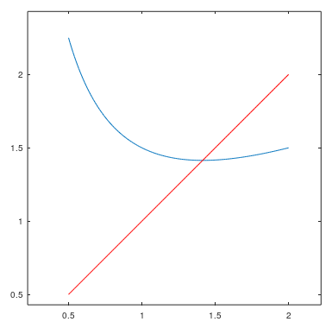
Fixed-point theorem
For example, in our previous problem,

Slide 9
Fixed-point theorem
We could now write a function to do this for us:
    double fixed_point( double f( double x ), double x0 ) {
    while ( true ) {
    double previous_x0{ x0 };
    x0 = f( x0 );
    if ( x0 == previous_x0 ) {
    return x0;
    }
    }
    }
    double sqrt2( double x ) {
    return x/2.0 + 1.0/x;
    }
int main() {
std::cout.precision( 16 );
std::cout
<< fixed_point( sqrt2, 1.4 )
<< std::endl;
return 0;
}

Slide 10
Fixed-point theorem
We could also author this in Matlab:
    function [x0] = fixed_point( f, x0 )
    while true
    previous_x0 = x0;
    x0 = f( x0 );
    if x0 == previous_x0
    return;
    end
    end
    end
    >> format long
    >> sqrt2 = @(x)( x/2.0 + 1.0/x );
    >> fixed_point( sqrt2, 1.4 )
    ans =
    1.414213562373095
This must be saved to a
file fixed_point.m

Slide 11
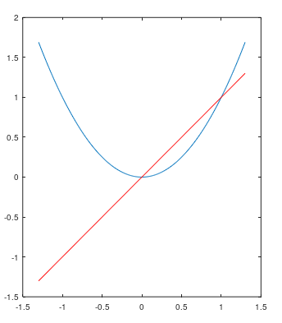
Fixed-point theorem
At the start of this topic, we looked at iterating
  The fixed-point theorem says that if an iteration converges,
  then that iteration converges
  to a solution of x = f (x)
  There are two solutions: 0 and 1
    If –1 < x₀ < 1,
    then the iteration converges to 0
    If x₀ = 1 or x₀ = –1,
    then the iteration converges to 1
    Otherwise, the iteration diverges

Slide 12
Diverging sequences
This leads to our first problem: When do we stop iterating?
  We must parameterize our algorithms to stop iterating
  after a given number of iterations
  We must also check to see if the iteration is no longer finite

Slide 13
Fixed-point theorem
We could now update our C++ function:
    double fixed_point( double f( double x ),
    double x0,
    unsigned int const max_iterations ) {
    for ( unsigned int iterations{0};
    iterations < max_iterations; ++iterations ) {
    double previous_x0{ x0 };
    x0 = f( x0 );
    if ( !std::isfinite( x0 ) ) {
    return NAN;
    }
    if ( x0 == previous_x0 ) {
    return x0;
    }
    }
    return NAN;
    }

Slide 14
Fixed-point theorem
We could also author this in Matlab:
    function [x0] = fixed_point( f, x0, max_iterations )
    for iterations = 1:max_iterations
    previous_x0 = x0;
    x0 = f( x0 );
    if ~isfinite( x0 )
    x0 = nan;
    return;
    end
    if x0 == previous_x0
    return;
    end
    end
    x0 = nan;
    return;
    end
>> format long
>> g = @(x)( x^2 );
>> fixed_point( g, 1.4, 1000 )
ans =
nan

Slide 15
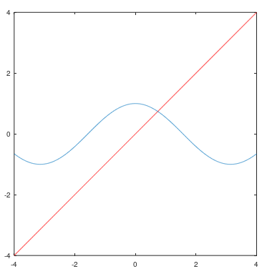
Fixed-point theorem
Suppose instead we start with
  This has a single solution close to x = 0.7391
  Given any x₀, then the iteration
  of this function f will converge
  to that one unique solution

Slide 16
Iterating the cosine function
Let us start with x₀ = 0.7:
    0.7
    0.7648421872844885
    0.7214916395975273
    0.7508213288394496
    0.7311287725733576
    0.7444211836271648
    0.7354802004059856
    0.7415086516600415
    0.7374504531501768
    0.7401852853967579
    0.7383436103510045
    0.7395844286953486
    0.7387487096620905
    0.7393117103380089
    0.7389324891697003
    0.7391879474695492
    0.7390158723904052
    0.7391317863671112
    0.7390537062865034
    0.7391063024073616
    0.7390708732270421
    0.7390947388395475
    0.7390786627169290
    0.7390894918051325
    0.7390821972095050
    0.7390871109407026
    0.7390838009939997
    0.7390860306147043
    0.7390845287157354
    0.7390855404131101
    0.7390848589216623
    0.7390853179825329
    0.7390850087536235
    0.7390852170539435
    0.7390850767403454
    0.7390851712572744
    0.7390851075895347
    0.7390851504768903
    0.7390851215874518
    0.7390851410477252
    0.7390851279390509

Slide 17
Iterating the cosine function
If we are applying iteration,
we don’t usually need 16 significant digits
    We seldom require more than six
  We don’t want to wait forever…
We will make an assumption:
  If |x_{n+1} – x_{n}| < ε_{step}, then x_{n+1} should also be close enough
  to whatever its converging to
    This is not necessarily true,
    but in most cases it is sufficient

Slide 18
Iterating the cosine function
Important: this is an absolute tolerance,
and not a relative tolerance
  If the solution is actually at x = 0,
  then the relative error is not even defined
  You must be aware of what you are expecting the solution
  to be to use such techniques

Slide 19
Fixed-point theorem
We could now update our C++ function:
    double fixed_point( double f( double x ),
    double x0,
    double step_tolerance,
    unsigned int const max_iterations ) {
    for ( unsigned int iterations{0};
    iterations < max_iterations; ++iterations ) {
    double previous_x0{ x0 };
    x0 = f( x0 );
    if ( !std::isfinite( x0 ) ) {
    return NAN;
    }
    if ( std::abs( x0 - previous_x0 ) < step_tolerance ) {
    return x0;
    }
    }
    return NAN;
    }

Slide 20
Fixed-point theorem
We could also author this in Matlab:
    function [x0] = fixed_point( f, x0, step_tolerance, max_iterations )
    for iterations = 1:max_iterations
    previous_x0 = x0;
    x0 = f( x0 );
    if ~isfinite( x0 )
    x0 = nan;
    return;
    end
    if abs( x0 - previous_x0 ) < step_tolerance
    return;
    end
    end
    x0 = nan;
    return;
    end
>> format long
>> fixed_point( @cos, 0.7, 1e-6, 1000 )
ans =
0.739084858921662
0.739085133215161

Slide 21
Summary
Following this topic, you now
  Understand how iteration can be used to solve analytic problems
  Have been exposed to the fixed-point theorem
  Understand that we must limit the number of iterations
    After all, the iteration may diverge, or take forever to converge
  We must also set the absolute tolerance for our solution

Slide 22
References
[1] https://en.wikipedia.org/wiki/Iteration
[2] https://en.wikipedia.org/wiki/Fixed-point_theorem

Slide 23
Acknowledgments
Tazik Shahjahan for pointing out typos.
An anonymous Class of 2025 student who noticed that
my iterative sequence was a geometric sequence!

Slide 24



Colophon
These slides were prepared using the Cambria typeface. Mathematical equations use Times New Roman, and source code is presented using Consolas. Mathematical equations are prepared in MathType by Design Science, Inc.
Examples may be formulated and checked using Maple by Maplesoft, Inc.
The photographs of flowers and a monarch butter appearing on the title slide and accenting the top of each other slide were taken at the Royal Botanical Gardens in October of 2017 by Douglas Wilhelm Harder. Please see
https://www.rbg.ca/
for more information.

Slide 25
Disclaimer
These slides are provided for the ece 204 Numerical methods course taught at the University of Waterloo. The material in it reflects the author’s best judgment in light of the information available to them at the time of preparation. Any reliance on these course slides by any party for any other purpose are the responsibility of such parties. The authors accept no responsibility for damages, if any, suffered by any party as a result of decisions made or actions based on these course slides for any other purpose than that for which it was intended.

